Slide 1
Introduction to Couchbase
A Practical Use Case
Rob Hedgpeth | Senior Developer Advocate, Mobile & IoT
4/18/2019

Slide 2

Who is this guy?
Robert Hedgpeth
Senior Developer Advocate, Mobile & IoT
robert.hedgpeth@couchbase.com
@probablyrealrob
rhedgpeth

Slide 3
AGENDA
01/
NoSQL
02/
Couchbase 101
03/
Couchbase Architecture
04/
User Profile Store
05/
Diving In
06/
Bringing it all together

Slide 4
NoSQL
1

Slide 5


The Database Landscape
Heritage
Modern

Slide 6
What is NoSQL?
Not SQL
Not Only SQL
Purpose built databases that have specific data models and flexible schemas for building modern applications.
NoSQL is the new categorization for various data models.
Not SQL
Notes:
NoSQL does not mean there is no SQL-Like interface
Couchbase N1QL
Cassandra Query Language

Slide 7
NoSQL Options
Key-Value
Document
Wide Column
Graph
Use simple data model that pairs a unique key and its associated value in storing data elements.
Store data elements in document-like structures that encode information in formats such as JSON.
Store data together as columns instead of rows and are optimized for queries over large datasets.
Emphasize connections between data elements, storing related “nodes” in graphs to accelerate querying.
Common uses
Clickstream data
Application logs
Common uses
Content management and monitoring
Web and mobile apps
Common uses
Search engines
Large scale web applications
Common uses
Recommendation engines
Geospatial applications
Notes:
Among the NoSQL databases, you will find four common models for storing data, which lead to four common types of NoSQL systems:
** Key-value stores ** are the simplest. Every item in the database is stored as an attribute name (or "key") together with its value. Riak, Voldemort, and Redis are the most well-known in this category.
** Wide-column stores ** store data together as columns instead of rows and are optimized for queries over large datasets. The most popular are Cassandra and HBase.
** Document databases ** pair each key with a complex data structure known as a document. Documents can contain many different key-value pairs, or key-array pairs, or even nested documents.
** Graph databases ** are used to store information about networks, such as social connections. Examples are Neo4J and HyperGraphDB.

Slide 8
Why NoSQL?
Notes:
NoSQL databases are a great fit for many modern applications such as mobile, web, and gaming that require flexible, scalable, high-performance, and highly functional databases to provide great user experiences.
Flexibility: NoSQL databases generally provide flexible schemas that enable faster and more iterative development. The flexible data model makes NoSQL databases ideal for semi-structured and unstructured data.
Scalability: NoSQL databases are generally designed to scale out by using distributed clusters of hardware instead of scaling up by adding expensive and robust servers. Some cloud providers handle these operations behind-the-scenes as a fully managed service.
High-performance: NoSQL database are optimized for specific data models (such as document, key-value, and graph) and access patterns that enable higher performance than trying to accomplish similar functionality with relational databases.
- Highly functional: NoSQL databases provide highly functional APIs and data types that are purpose built for each of their respective data models.

Slide 9
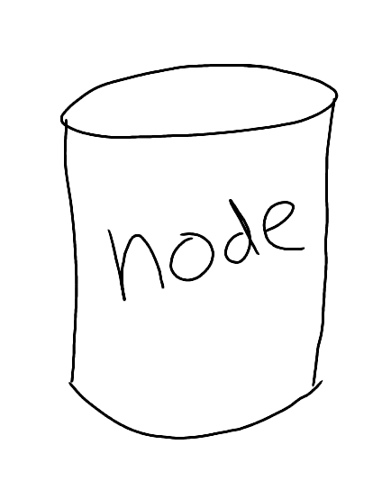
Why NoSQL? Scalability
Notes:
Elastic scaling
Size your cluster for today
Scale out on demand
Cost effective scaling
Commodity hardware
On premise or on cloud
Scale OUT instead of Scale UP
[example: changing the channel to a soccer game or Game of Thrones, everyone makes the same API request in the same 5 minutes]
[example: TV show lets watchers vote during some period of the week, so you can scale up during that period of time]
[example: black Friday]

Slide 10
Why NoSQL? Flexibility
Notes:
Schema flexibility
Easier management of change in the business requirements
Easier management of change in the structure of the data
Sometimes you're pulling together data, integrating from different sources (e.g. ELT) and that flexibility helps
Document database means that you have no rigid schema. You can do whatever the heck you want.
That being said, you SHOULDN’T. You should still have discipline about your data.

Slide 11
Why NoSQL? Availability
Notes:
If one Smith goes down, Neo can just start fighting another one.
Or if you need to perform maintenance, upgrade, etc., you don't have to take the whole system down
**This is related to scaling**
Built-in replication and fail-over
No application downtime when hardware fails
Online maintenance & upgrade
No application downtime

Slide 12

Why NoSQL? Performance
Notes:
- NoSQL systems are optimized for specific access patterns
- Low response time for web & mobile user experience
Millisecond latency
- Consistently high throughput to handle growth
[perf measures can be subjective – talk about architecture, integrated cache, maybe mention MDS too]

Slide 13
Which NoSQL?
Document
Key-Value
Couchbase
MongoDB
CosmosDB
Couchbase
BerkeleyDB
Redis
NoSQL
Wide Column
Graph
Hbase
Cassandra
Hypertable
OrientDB
Neo4J
GraphBase

Slide 14
Document Based Databases
Document
Get by key(s)
Set by key(s)
Replace by key(s)
Delete by key(s)
Map/Reduce
Couchbase
MongoDB
CosmosDB
Notes:
When we look at document databases, they originally came with a
Minimal set of APIs and features
But as they continue to mature, we’re seeing more features being added
And generally I’m seeing a convergent trend between SQL and NoSQL
More robust querying capabilities
But anyway, this set of minimal features, lacking a SQL language and tables gives us the buzzword “nosql”
MapReduce views
MapReduce views (also called views) are JavaScript functions defined on documents in a Couchbase bucket. Views are built incrementally, re-indexing only the documents that have changed since the last index update. Couchbase Server precomputes and stores view results before returning the results to the client. The data service is responsible to handle MapReduce views.

Slide 15

So, you want to do a little Couchbase’n
Document
Couchbase
MongoDB
CosmosDB

Slide 16
Couchbase 101
2

Slide 17
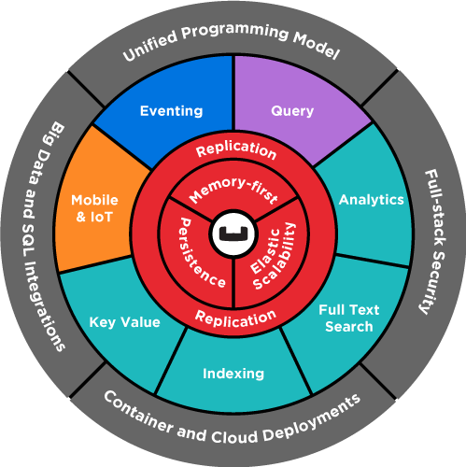
The Couchbase Data Platform
Notes:
Couchbase Server is an open source, distributed, NoSQL document-oriented engagement database. It exposes a fast key-value store with managed cache for sub-millisecond data operations, purpose-built indexers for fast queries and a powerful query engine for executing SQL-like queries. For mobile and Internet of Things environments Couchbase also runs natively on-device and manages synchronization to the server.
Couchbase Server is specialized to provide low-latency data management for large-scale interactive web, mobile, and IoT applications.
Common requirements that Couchbase Server was designed to satisfy include:
- Unified Programming Interface
- Query
- Search
- Mobile and IoT
- Analytics
- Core database engine
- Scale-out architecture
- Memory-first architecture
- Big data and SQL integrations
- Full-stack security
- Container and Cloud deployments
- High Availability

Slide 18
Couchbase Core Principles
Auto sharding
JSON-based flexible data model
Memory-first architecture
Asynchronous approach to everything
Scale workloads independently
Managed Cache
Key-Value Store
Document Database
N1QL
Query
Full Text Search
Eventing
Mobile
Analytics

Slide 19



Couchbase Core Principles
Direct Access
N1QL
Query
Full Text Search
Notes:
1.) Direct access: Retrieving, saving, and deleting directly using the Data Service.
2.) Creating more complex queries using N1QL (”nickel”). N1QL is a querying language very similar to SQL.
3.) Implementing Full-Text Search

Slide 20
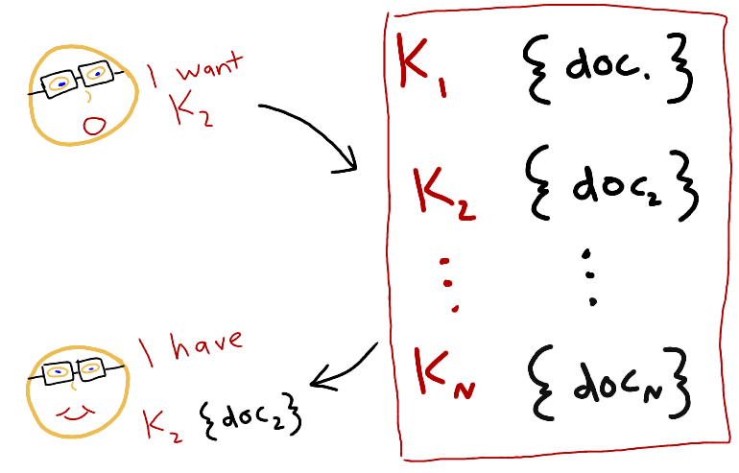
Direct Access
Notes:
Think of a document database at the simplest as a type
of a key/value store, where the value is in a known format
You write code where you start with a key, and you ask the database to return the document
That corresponds to that key.
And the same with creating/updating

Slide 21
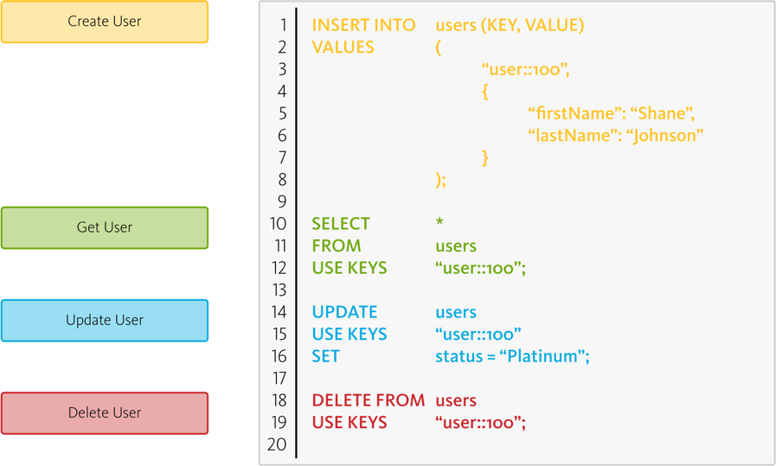
Data Access: N1QL = SQL for JSON
SELECT *
FROM user
WHERE users.lastName = “Johnson”
UPDATE users
SET status = “Platinum”
WHERE users.lastName = “Johnson”
DELETE
FROM users
WHERE users.firstName = “Shane”
Notes:
The N1QL language structure is composed of statements, expressions, and comments.
Provides multiple data access paths to query and manage your JSON documents. App developers can pick the data access pattern that best meets their requirements. Flexible data access paths makes Couchbase useful for a wide variety of apps and use cases.
Couchbase Server can be queried using N1QL, an expressive, powerful, and complete SQL dialect for querying, transforming, and manipulating JSON data. As SQL, it’s immediately familiar to developers who can quickly start developing rich applications. Unlike other NoSQL databases, Couchbase supports JOIN operations, enabling a wide range of data models. To help users develop rich applications with agility, N1QL is supported by a rich index infrastructure and also has extensions that allow it to handle heterogeneous documents with nested structures. N1QL is accessible to a full range of tools for analytics and data integration via JDBC and ODBC, such as Microsoft Excel and Tableau.

Slide 22
Full Text Search
Alex┊
SEARCH
Inverted Index
Term matching
Scoring
Context snippet
Search results
Scoring | Document ID | firstName Matches
1.88 | user::1 | Alex
1.72 | user::2 | Alexx
1.37 | user::3 | Alec
Notes:
Full Text Search provides extensive capabilities for natural-language querying. These include:
Language-aware searching; allowing users to search for, say, the word beauties, and additionally obtain results for beauty and beautiful.
Scoring of results, according to relevancy; allowing users to obtain result-sets that only contain documents awarded the highest scores. This keeps result-sets manageably small, even when the total number of documents returned is extremely large.
- Fast indexes, which support a wide range of possible text-searches.
Full Text Search is powered by Bleve, an open source search and indexing library written in Go.
Built-in full-text search makes it simple for developers to add intelligence to apps. Full text indexes are automatically managed within the Couchbase cluster, avoiding the time delay, overhead, and complexity of managing a separate full-text search product and infrastructure.
One of the important requirements in a User profile Store is to quickly search for a user or to quickly search through all the history of interactions with them. This feature could enable, for instance, a better post-sales experience in retail or a more accessible patient history in a health care system.
For many years developers have been using pure SQL to implement these types of functionalities. However, this type of technology has proven to be inefficient to deal with language nuances and limited in terms of performance.
Searching for people’s name, for instance, is a tricky scenario, where the same name might have dozens of variations. In this session, let’s try to solve this issue by enhancing our users listing using Couchbase Full-Text Search on it. The goal is to implement a simple search that is able to return users called Allex or Alec when we search for Alex.

Slide 23
Couchbase Architecture
3

Slide 24
Couchbase Server
Notes:
Node
A single Couchbase Server instance running on a physical server, virtual machine, or a container. All nodes are identical: they consist of the same components and services and provide the same interfaces.
Cluster
A cluster is a collection of nodes that are accessed and managed as a single group. Each node is an equal partner in orchestrating the cluster to provide facilities such as operational information (monitoring) or managing cluster membership of nodes and health of nodes.
Clusters are scalable. You can expand a cluster by adding new nodes and shrink a cluster by removing nodes.
The Cluster Manager is the main component that orchestrates the cluster level operations. For more information, see Cluster Manager.
Bucket
A bucket is a logical container for a related set of items such as key-value pairs or documents. Buckets are similar to databases in relational databases. They provide a resource management facility for the group of data that they contain. Applications can use one or more buckets to store their data.
Through configuration, buckets provide segregation along the following boundaries:
- Cache and IO management
- Authentication
- Replication and Cross Datacenter Replication (XDCR)
- Indexing and Views
Item
Item is the basic unit of data in a Couchbase Server. An item is a key-value pair where each stored value is identified by a unique key within the bucket.
This is different from relational databases which store data in databases grouped by tables. Tables have a strict schema (set of columns) and data is stored in rows in tables.
Values for an item can be anything from a single bit, to a decimal measurement, to JSON documents. Storing data as a JSON document allows the Couchbase Server to provide extended features such as indexing and querying. Items are also referred to as documents, objects, or key-value pairs.
vBucket
vBuckets are physical partitions of the bucket data. By default, Couchbase Server creates a number of master vBuckets per bucket (typically 1024) to store the bucket data. Buckets may store redundant copies of data called replicas. Each replica also creates another set of vBuckets to mirror the active vBucket. The vBuckets that maintain replica data are called replica vBuckets. Every bucket has its own set of active and replica vBuckets and those vBuckets are evenly distributed across all nodes within the data service.
Cluster map
The cluster map contains a mapping of which services belong to which nodes at a given point in time. This map exists on all Couchbase nodes as well as within every instantiation of the client SDK. Through this map, the application is able to transparently identify the cluster topology and respond when that topology changes. Cluster map contains a vBucket map.
vBucket map
A vBucket map contains a mapping of vBuckets to nodes at a given point in time. This map exists on all Couchbase nodes as well as within every instantiation of the client SDK. Through this map, the application is able to transparently identify the nodes that contain the vBuckets for a given key and respond when the topology changes.
Replication
Replication is the process of creating additional copies of active data on alternate nodes. Replication is at the heart of the Couchbase Server architecture enabling high availability, disaster recovery, and data exchange with other big data products. It is the core enabler for
Moving data between nodes to maintain replicas.
Geo-distribution of data with cross datacenter replication (XDCR)
Queries with incremental map-reduce and spatial views
Backups with full or incremental snapshots of data
Integration with Hadoop, Kafka and text search engines based on Lucene like Solr
For more information about replication, see High availability and replication architecture.
Rebalance
The topology of a cluster can change as nodes are added or removed due to capacity requirements or node failures. As the number of nodes changes, the rebalance operation is used to redistribute the load and adapt to the new topology of nodes. At its core, a rebalance operation for the data service is the incremental movement of vBuckets from one node to another. By moving vBuckets onto or off of nodes, these nodes become responsible for more or less data and begin handling more or less traffic from the applications. A rebalance operation also brings in or takes out nodes from the various services. While the rebalance operation is in progress, it also updates the cluster map on all clients with any topology changes. The Cluster Manager coordinates the movement and hand off of vBuckets and services during the rebalance operation. Rebalance is performed completely online and with minimal impact to the incoming workload.
Failover
Failover is the process that diverts traffic away from failing nodes to the remaining healthy nodes. Failover can be done automatically by the Couchbase cluster based on the health status of a node, or can be done manually by the administrator or an external script. A node that is failed over does not accept any new traffic.
Node lifecycle
As the cluster topology changes, nodes in the cluster go through a set of state transitions. Operations such as Add Node, Remove Node, Rebalance, and Failover cause state transitions. The following diagram lists the states and state transitions of the nodes in the cluster.

Slide 25
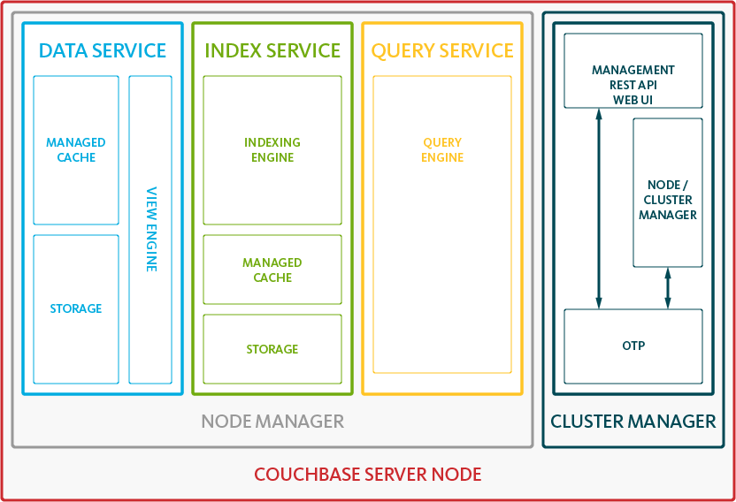
Couchbase Architecture
Data Service – Stores documents, builds and maintains Distributed Secondary Indexes (MapReduce Views)
Query Service – Plans, coordinates, and executes queries against either Global or Distributed Indexes
Index Service – Builds and maintains Global Secondary Indexes
Search Service – Builds, maintains and queries Full Text Search indexes
Analytics Service – Massively Parallel Processing (MPP) Architecture for running ad-hoc queries and large-scale aggregations
Eventing Service – User-defined functions, triggers and timers
Cluster Manager – Configuration, heartbeat, statistics, RESTful Management interface
Notes:
Couchbase services are components that run specific independent workloads within the cluster. Databases handle three distinct workloads: core data operations, indexing, and query processing. Couchbase Server includes Data, Index, Search, and Query Services to enable independent deployment of these workloads within a cluster.
Each node can run all services or a subset of the services. As an administrator, you can create unique topologies using these independent services and independently scale the three workloads. For more information, see Services architecture and multidimensional scaling.
Couchbase Server provides the following services:
1.) Data: Supports the storing, setting, and retrieving of data-items, specified by key.
2.) Query: Parses queries specified in the N1QL query-language, executes the queries, and returns results. The Query Service interacts with both the Data and Index services.
3.) Index: Creates indexes, for use by the Query and Analytics services.
4.) Search: Create indexes specially purposed for Full Text Search. This supports language-aware searching; allowing users to search for, say, the word beauties, and additionally obtain results for beauty and beautiful.
5.) Analytics: Supports join, set, aggregation, and grouping operations; which are expected to be large, long-running, and highly consumptive of memory and CPU resources.
6.) Eventing: Supports near real-time handling of changes to data: code can be executed both in response to document-mutations, and as scheduled by timers.
The Cluster Manager handles the cluster level operations and the coordination between nodes in a Couchbase Server cluster. These management functions include configuring nodes, monitoring nodes, gathering statistics, logging, and controlling data rebalancing among cluster nodes. The cluster manager determines the node’s membership in a cluster, responds to heartbeat requests, monitors its own services and repairs itself if possible.
MapReduce views
MapReduce views (also called views) are JavaScript functions defined on documents in a Couchbase bucket. Views are built incrementally, re-indexing only the documents that have changed since the last index update. Couchbase Server precomputes and stores view results before returning the results to the client. The data service is responsible to handle MapReduce views.
Unlike the view index that indexes only a subset of the data local to each data node, global secondary indexes are global across the cluster. Global secondary indexes index the entire bucket’s data in a single location and reside on the index nodes. The index service is responsible to handle GSIs.

Slide 26
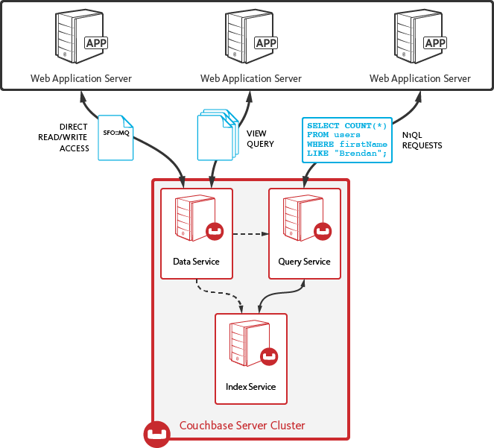
Application To Database Interaction

Slide 27
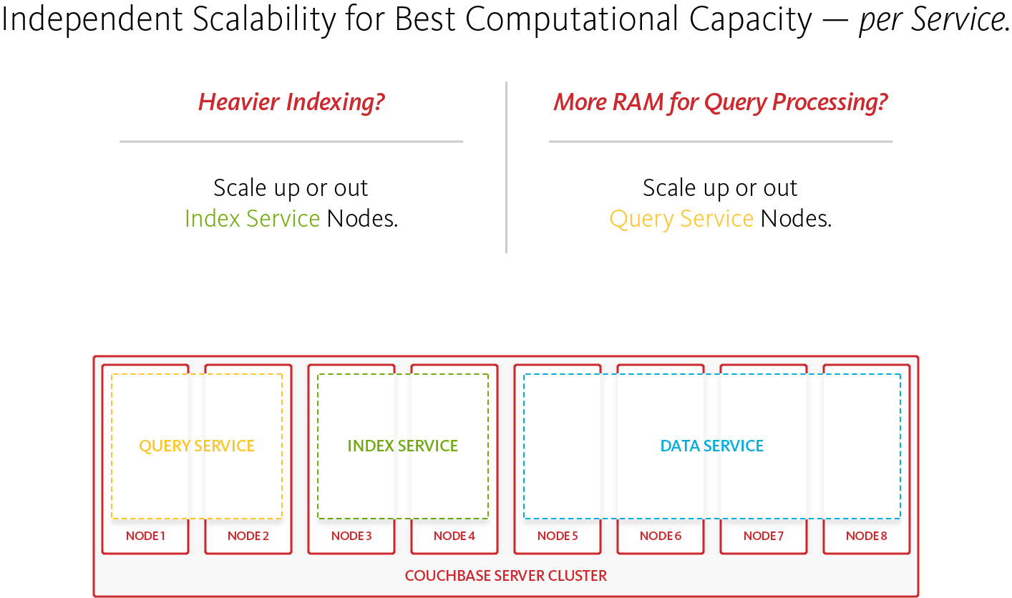
Modern Architecture – Multi-Dimensional Scaling

Slide 28
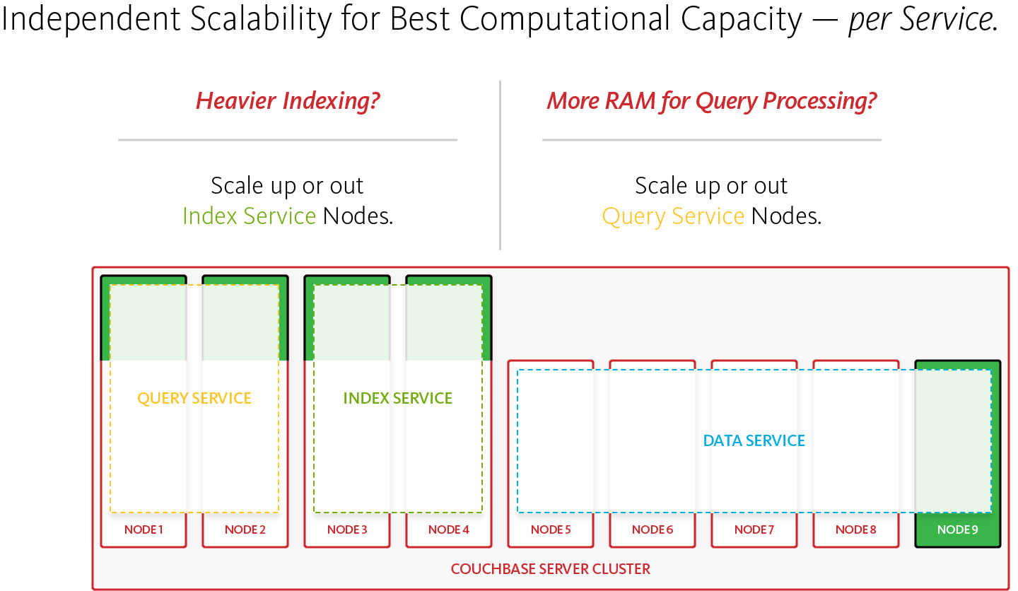
Modern Architecture – Multi-Dimensional Scaling

Slide 29
Scale & High Availability
APP SERVER 1
APP SERVER 2
APP SERVER 3
Scale on demand with automatic partitioning and rebalancing
Build always-available apps with memory-to-memory replication and automatic failover
Simplify development with topology-aware clients and direct communication
Client Library
Client Library
Client Library
Cluster Map
Cluster Map
Cluster Map
Couchbase Server 1
Couchbase Server 2
Couchbase Server N
ACTIVE
ACTIVE
ACTIVE
REPLICA
REPLICA
REPLICA
Server Cluster
Notes:
Let’s take a closer look on how we achieve elastic scaling and high availability…
First of all, we take your data and automatically distribute it evenly across all the nodes - see the active partitions on each node.
We will also automatically redistribute and rebalance the data when you add or remove nodes, all without any downtime
You can also specify one or more replicas for you data for high availability. The system will intelligently place the replicas on different nodes on different available zones to maximize availability, and will detect and recover from failures automatically.
With our smart clients that is topology aware, we avoid the need for proxy servers, simplifying deployment and improving performance.
The cluster map on the client side will be automatically updated to reflect the latest cluster topology.

Slide 30
Memory-first architecture
Data movement free from disk bottlenecks
COUCHBASE SERVER CLUSTER
Node 1
Node 2
Node 3
Node 4
Node 5
Node 6
Data Service
Data Service
Global
Index Service
Query Service
Query
Service
Full Text Service
DCP
Streaming
DCP
Streaming
In-memory streaming of updates to all components
In-memory cache
Memory-only data buckets option
Memory-only indexes option

Slide 31
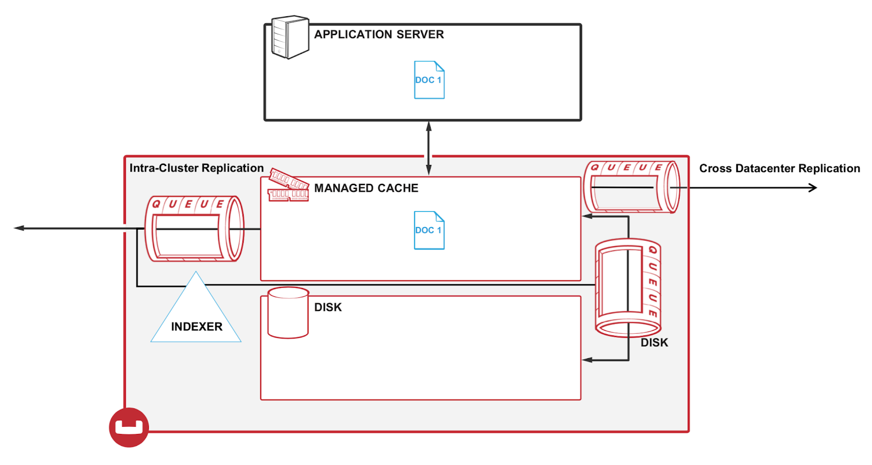
Asynchronous approach to everything
Efficient, highly available and non-blocking processes
Persistence
Database change protocol stream
Intra-cluster replication
Inter-cluster replication
Global secondary indexing updates
Full-Text index updates
Analytics service updates

Slide 32
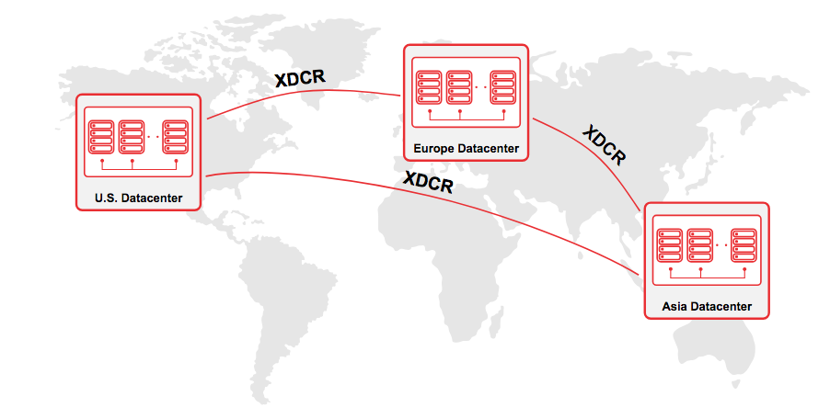
Cross Data Center Replication (XDCR)
Notes:
Core principles behind this technology - https://blog.couchbase.com/understanding-xdcr-part-1/
Highly performant : XDCR is highly performant replication system operating at the speed of network and memory with very low latency. Replication is memory to memory.
Independently scalable system : XDCR has a peer to peer architecture where clusters can be added or removed and every cluster in the topology can be scaled up or down without impacting other clusters.
Infrastructure agnostic : XDCR can be used to replicate data between any two couchbase clusters irrespective of their deployment platform as bare metal, VMs, private cloud, public cloud, hybrid or containers.
Topology aware : XDCR is topology aware, as nodes are added to / removed from clusters, system adjusts and manages replication accordingly, without any manual intervention.
Simplified setup and administration: XDCR can be set up in <15 secs, between any two Couchbase clusters. Once set up, the documents are continuously synchronized between source and target. It operates without any manual intervention even during topology changes like failover or rebalance.
Flexible topology : Unidirectional, bidirectional, hub & spoke, ring, mesh etc., any complex topology can be set up.
Resilient : Incase of any network failures, XDCR can resume replication from where it was interrupted. XDCR also continuously retries until the replication is successful.

Slide 33
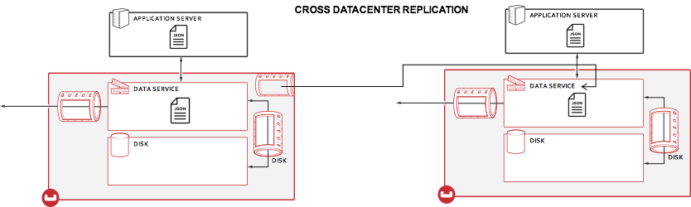
Cross Data Center Replication (XDCR)
Memory to memory
Unidirectional or bidirectional
Active/active or active/passive
Configuration per bucket
Filtering capabilities
Encryption with SSL
Auto/on demand replication
Multi-cloud deployments
Notes:
Core principles behind this technology - https://blog.couchbase.com/understanding-xdcr-part-1/
Highly performant : XDCR is highly performant replication system operating at the speed of network and memory with very low latency. Replication is memory to memory.
Independently scalable system : XDCR has a peer to peer architecture where clusters can be added or removed and every cluster in the topology can be scaled up or down without impacting other clusters.
Infrastructure agnostic : XDCR can be used to replicate data between any two couchbase clusters irrespective of their deployment platform as bare metal, VMs, private cloud, public cloud, hybrid or containers.
Topology aware : XDCR is topology aware, as nodes are added to / removed from clusters, system adjusts and manages replication accordingly, without any manual intervention.
Simplified setup and administration: XDCR can be set up in <15 secs, between any two Couchbase clusters. Once set up, the documents are continuously synchronized between source and target. It operates without any manual intervention even during topology changes like failover or rebalance.
Flexible topology : Unidirectional, bidirectional, hub & spoke, ring, mesh etc., any complex topology can be set up.
Resilient : Incase of any network failures, XDCR can resume replication from where it was interrupted. XDCR also continuously retries until the replication is successful.

Slide 34
User Profile store
4

Slide 35
User Profile Store
One of the most common paradigms in software architecture is to centralize the code responsible for managing user’s data.
Any user-related data.
Name, Username, Password, Addresses, etc.
Use cases
Transaction history (Finance)
Orders (eCommerce)
Medical history (Healthcare)

Slide 36
Why Couchbase?
Strong Consistency
Operations by key are strongly consistent, so you won’t get outdated data.
High read and write throughput
Couchbase Server has a memory-first architecture. Data can be retrieved with very low latency and writes are asynchronous by default.
Caching
Frequently accessed data is automatically cached, as Couchbase has a managed cache on top of the database
A flexible data model
User data can vary a lot depending on the needs of different roles, levels, etc.

Slide 37
Why Couchbase?
Easy and fast querying:
With N1QL, you can query all your data with a powerful SQL-like language. In addition, you can also keep your indexes in memory with Memory Optimized Indexes.
Natural-Language matching
With full-text search you can easily implement advanced searches on natural-language texts.
High Scalability
Couchbase makes it easy to scale horizontally, and it makes it easy to scale individual services vertically with multi-dimensional scaling.
High Availability
No single point of failure. Data can also be located in one or multiple data centers (via XDCR)
Notes:
Memory Optimized Indexes (add details)

Slide 38
Diving In
5

Slide 39
Installing Couchbase Server
How?
Like an animal Manually
Using Docker
Using a Couchbase Autonomous Operator to create and manage a Couchbase cluster using:
Kubernetes
OpenShift
Where?

Slide 40
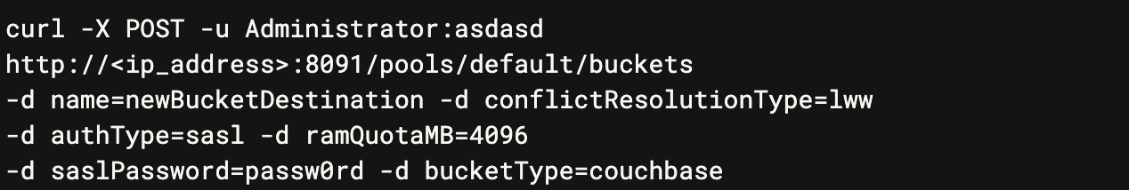
Accessing & Configuring Couchbase Server
CLI
API
Web UI
Notes:
CLI: https://docs.couchbase.com/server/6.0/cli/cli-intro.html
API: https://docs.couchbase.com/server/6.0/rest-api/rest-intro.html

Slide 41
Integrating with Couchbase Server
APIs
SDKs

Slide 42
Intelligent Application SDK – Single API
New Data Stream
APP
APP
APP
WEB APPLICATION SERVERS
Direct read/write access
SELECT COUNT(*)
FROM users
WHERE firstName LIKE “Brandan”;
SFO=MQ
View Query
N1QL Requests
Data Service
Query Service
Index Service
Couchbase Server Cluster

Slide 43
Couchbase Server SDK’s
Couchbase offers a number of software development kits (SDKs) that enable programmatic access to Couchbase Server.
C SDK 2.4/2.5 The Couchbase C SDK provides a fast, callback-based API for interacting with your Couchbase cluster.
Go SDK 1.0 The Couchbase Go SDK is a native Go library and uses the high-performance gocbcore to handle communicating to the cluster over Couchbase’s binary protocols.
Java SDK 2.2 The Couchbase Java SDK provides synchronous/asynchronous (reactive) interfaces that allow your applications to interact with a Couchbase Server cluster.

Slide 44
Couchbase Server SDK’s
.NET SDK 2.2 The .NET Couchbase SDK provides a way to store and retrieve your objects to and from a Couchbase cluster.
Node.js SDK 2.0/2.1 This is a native Node.js module and uses Couchbase’s high performance C library to handle communicating to the cluster over Couchbase’s binary protocols.
PHP SDK 2.0/2.1 The Couchbase PHP SDK is a native PHP extension and uses the Couchbase high-performance C library to handle communicating to the cluster over Couchbase binary protocols.
Python SDK 2.0 The Couchbase Python SDK is written as a fast C extension with support for a traditional synchronous API, as well as gevent and twisted APIs for high performance asynchronous programming.

Slide 45
The tip of the iceberg
6

Slide 46
Bringing it all together
What is NoSQL and why would I use it?
So many options! Which do I choose?
Getting started with Couchbase Server
Key features
Architecture
Installation
Accessing data
CLI
API
SDKs

Slide 47
What’s next?
User Profile Store Tutorials
.NET: https://docs.couchbase.com/tutorials/profile-store/dotnet.html.
Java: https://docs.couchbase.com/tutorials/profile-store/java.html
Blog: https://blog.couchbase.com
Forums: https://forums.couchbase.com/
Documentation: https://docs.couchbase.com/home/index.html
Community: https://www.couchbase.com/community
robert.hedgpeth@couchbase.com
@probablyrealrob
rhedgpeth

Slide 48
Thank you

